Slide 1
Intro to AWS: Storage Services

Slide 2



Amazon S3 Simple Storage Service

Slide 3
Amazon S3
Amazon S3 is object storage built to store and retrieve any amount of data from anywhere on the Internet. It’s a simple storage service that offers an extremely durable, highly available, and infinitely scalable data storage infrastructure at very low costs.

Slide 4
What can be done with Amazon S3
Amazon S3 provides a simple web service interface that you can use to store and retrieve any amount of data, at any time, from anywhere on the web. Using this web service, you can easily build applications that make use of Internet storage. Since Amazon S3 is highly scalable and you only pay for what you use, you can start small and grow your application as you wish, with no compromise on performance or reliability.

Slide 5
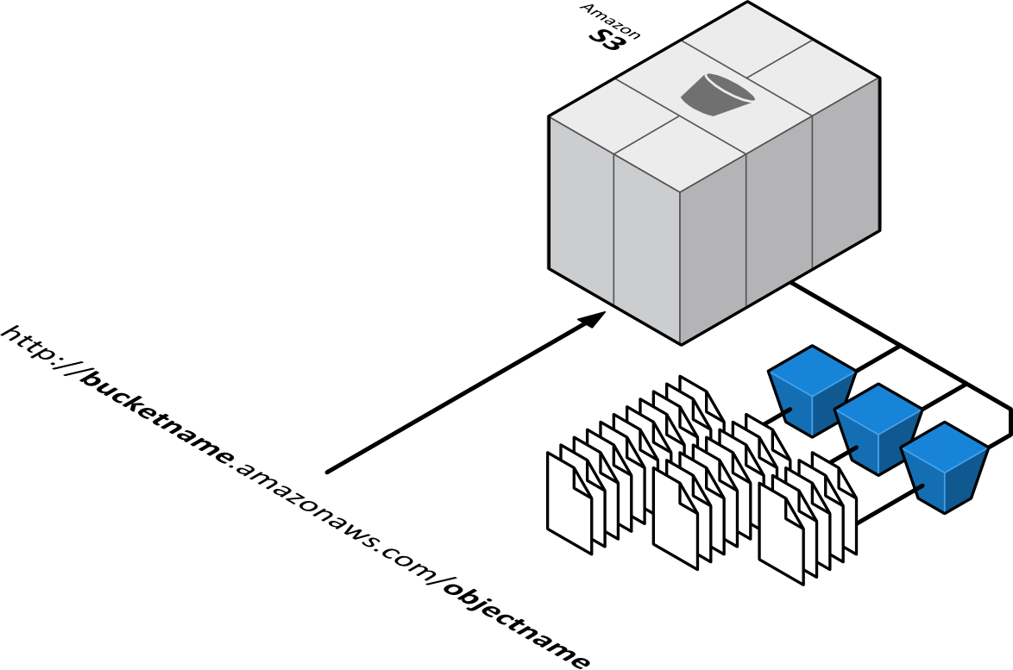
S3 resources: buckets and objects

Slide 6
Types of Amazon S3 Storage

Slide 7
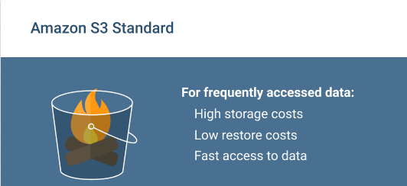
Amazon S3 Standard
High capacity and low latency.
Reliability at 99,999999999% level (of 100 billion objects per year, you are at risk of losing only one of them).
Availability at 99,99% level (of 10 thousand hours, within one hour the data will be unavailable).
Use of the storage is covered by Amazon S3 Service Level Agreement, which considers compensation if the level of uninterrupted operation is lower than it was declared
Standard storage is suitable for the following usage scenarios such as Website hosting, Cloud applications and web-services, Mobile games and apps, Big data, Content distribution.

Slide 8
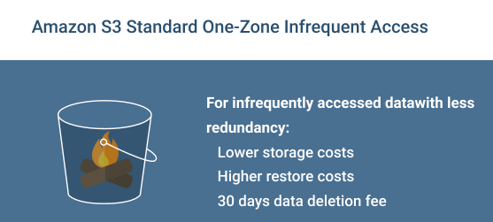
Amazon S3 Standard Infrequent Access
Amazon S3 IA is designed for the data which require less frequent access, but with longer storage time than in case of Standard.
Low delays combined with high capacity and reliability 99,999999999% insure the safety of object for a long period of time. Amazon S3 IA differs from Standard in the following way:
Availability at 99.9% level within a year (e.g., the probability of request error is a little higher than in standard storage).
You are charged for data retrieval.

Slide 9
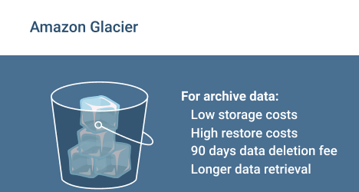
Amazon Glacier
Amazon Glacier is a perfect solution for long storage and archiving of data which don’t require instant access. The service allows storing large or small volumes of data at low cost. At the same time, the retrieval process may take several hours. Amazon Glacier differs from S3 Standard in the following way:
Extremely low cost.
Uninterrupted operation is not guaranteed by the Amazon S3 Service Level Agreement.
The minimum period of storage is 90 days.
The typical example of use is the storage of data archives are Media resources archives (news bulletins), Archives of organizations working in the health area (patients information), Data obtained during scientific researches, Backup copies of databases with long storage.

Slide 10
Amazon S3—New Features

Slide 11
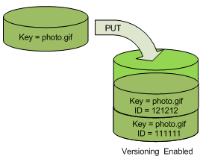
S3 versioning
Preserve, retrieve, and restore every version of every object stored in your bucket
S3 automatically adds new versions and preserves deleted objects with delete markers unless an explicit versioned DELETE operation is made
Easily control the number of versions kept by using lifecycle expiration policies
Easy to turn on in the AWS Management Console

Slide 12
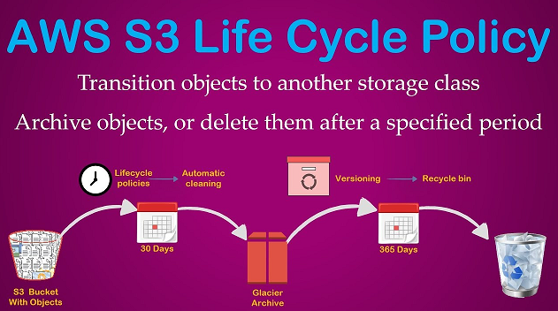
S3 Lifecycle Policies

Slide 13
Block Storage

Slide 14

Amazon EBS Elastic Block Storage

Slide 15
Amazon EBS allows you to create storage volumes and attach them to Amazon EC2 instances. Once attached, you can create a file system on top of these volumes, run a database, or use them in any other way you would use block storage.
EBS volumes are created in a specific Availability Zone, and can then be attached to any instances in that same Availability Zone. To make a volume available outside of the Availability Zone, you can create a snapshot and restore that snapshot to a new volume anywhere in that Region. You can copy snapshots to other Regions and then restore them to new volumes there, making it easier to leverage multiple AWS Regions for geographical expansion, data center migration, and disaster recovery.

Slide 16
Types of Amazon EBS Elastic Block Storage

Slide 17
Magnetic Type (Old Generation) :-
EBS Magnetic volumes are backed by hard disk drives (HDDs) and can be used for workloads with smaller datasets where data is accessed infrequently or when performance consistency isn't of primary importance.
Volume Type: EBS Magnetic
Volume Size: 1 GB - 1 TB
Max IOPS: No IOPS
Use Case: Infrequent Data Access

Slide 18
General Purpose SSD
General Purpose SSD volumes offer a base performance of 3 IOPS/GiB, with the ability to burst to 3,000 IOPS for extended periods of time. These volumes are ideal for a broad range of use cases such as boot volumes, small and medium-size databases, and development and test environments.
Volume Size: 1 GB – 16 TB
Max IOPS: 10,000 IOPS
Use Case: Web Application

Slide 19
General Purpose SSD gp2
Volume Type: EBS General Purpose SSD (gp2) * Short Description: General Purpose SSD volume that balances price performance for a wide variety of transactional workloads Use Cases: Boot volumes, low-latency interactive apps, dev. & test API Name: gp2 Volume Size: 1 GB – 16 TB
Durability: 99.8% - 99.9% durability Max IOPS**/Volume: 16,000 Max Throughput***/Volume: 250 MB/s Max IOPS/Instance: 260,000 Max Throughput/Instance: 7,500 MB/s
Latency: single digit millisecond Price: $0.10/GB-month Dominant Performance Attribute: IOPS
*Default volume type **io1/io2/gp2 based on 16K I/O size, st1/sc1 based on 1 MB I/O size ***volume throughput is calculated as MB = 1024^2 bytes

Slide 20
General Purpose SSD gp3
Volume Type: EBS General Purpose SSD (gp3) Short Description: General Purpose SSD volume that balances price performance for a wide variety of transactional workloads Use Cases: virtual desktops, medium sized single instance databases such as MSFT SQL Server and Oracle DB, low-latency interactive apps, dev. & test, boot volumes API Name: gp3 Volume Size: 1 GB – 16 TB Durability: 99.8% - 99.9% durability Max IOPS/Volume: 16,000 Max Throughput*/Volume: 1000 MB/s Max IOPS/Instance: 260,000 Max Throughput/Instance: 7,500 MB/s
Latency: single digit millisecond Storage Price: $0.08/GB-month
Provisioned Performance Price: 3,000 IOPS free and $0.005/provisioned IOPS-month over 3,000 IOPS; 125 MB/s free and $0.04/provisioned MB/s-month over 125 MiBps Dominant Performance Attribute: $/IOPS

Slide 21
Provisioned IOPS SSD
Provisioned IOPS SSD volumes support up to 64,000 IOPS and 1,000 MiB/s of throughput. This allows you to predictably scale to tens of thousands of IOPS per EC2 instance.
Volume Size: 1 GB – 16 TB
Max IOPS: 64,000 IOPS
Use Case: DB server

Slide 22
Provisioned IOPS SSD io1:
Volume Type: EBS Provisioned IOPS SSD (io1)
Short Description: High performance SSD volume designed for latency-sensitive transactional workloads Use Cases: I/O-intensive NoSQL & relational databases API Name: io1 Volume Size: 4 GB – 16 TB
Durability: 99.8% - 99.9% Max IOPS*/Volume: 64,000 Max Throughput**/Volume: 1,000 MB/s Max IOPS/Instance: 260,000
Max IOPS/GB: 50 IOPS/GB Max Throughput/Instance: 7,500 MB/s
Latency: single digit millisecond Price: $0.125/GB-month + $0.065/provisioned IOPS-month Dominant Performance Attribute: IOPS
*io1/io2/gp2 based on 16K I/O size, st1/sc1 based on 1 MB I/O size **volume throughput is calculated as MB = 1024^2 bytes

Slide 23
Provisioned IOPS SSD io2:
To achieve the limit of 64,000 IOPS and 1,000 MB/s throughput, the volume must be attached to an EC2 instance built on the AWS Nitro System.
Volume Type: EBS Provisioned IOPS SSD (io2)
Short Description: High performance SSD volume designed for business-critical latency-sensitive applications
Use Cases: I/O-intensive NoSQL & relational databases API Name: io2 Volume Size: 4 GB – 16 TB Durability: 99.999% Max IOPS*/Volume: 64,000 Max Throughput**/Volume: 1,000 MB/s Max IOPS/Instance: 160,000
Max IOPS/GB: 500 IOPS/GB Max Throughput/Instance: 4,750 MB/s
Latency: single digit millisecond

Slide 24
Throughput Optimized HDD
Throughput Optimized HDD volumes provide low-cost magnetic storage that defines performance in terms of throughput rather than IOPS. These volumes are ideal for large, sequential workloads such as Amazon EMR, ETL, data warehouses, and log processing.
Short Description: Low cost HDD volume designed for frequently accessed, throughput-intensive workloads.
Volume Type: Throughput Optimized HDD (st1)
Volume Size: 125 GB – 16 TB
Max IOPS: 250 IOPS
Use Case: Test work environment, Big data, data warehouses, log processing

Slide 25
Cold HDD
Cold HDD volumes provide low-cost magnetic storage that defines performance in terms of throughput rather than IOPS. These volumes are ideal for large, sequential, cold-data workloads. If you require infrequent access to your data and are looking to save costs, these volumes provides inexpensive block storage.
Short Description: Lowest cost HDD volume designed for less frequently accessed workloads.
Volume Size: 125 GB – 16 TB
Max IOPS: 250 IOPS
Use Case: Colder data requiring fewer scans per day
API Name: sc1

Slide 26
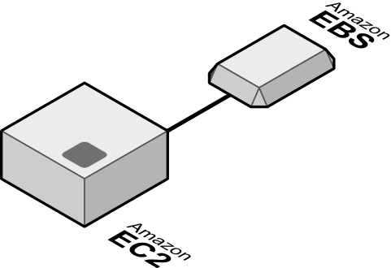

Slide 27
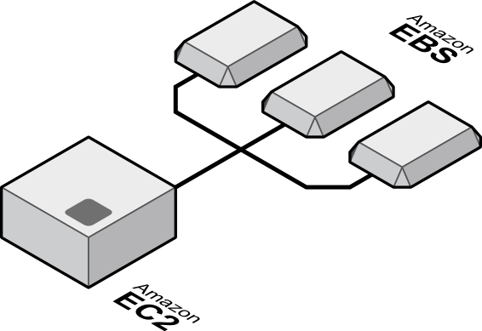

Slide 28

EBS
Price
Performance
 | Magnetic | General Purpose | Provisioned IOPS
Use cases | Infrequent data access | Boot volumes Small to med DBs Dev and Test | I/O intensive Relational DBs NoSQL DBs
Storage media | Magnetic disk- backed | SSD-backed | SSD-backed
Max IOPS | 40–200 IOPS | 10,000 IOPS | 20,000 IOPS
Latency (random read) | 20–40 ms | 1–2 ms | 1–2 ms
Availability | Designed for 99.999% | Designed for 99.999% | Designed for 99.999%
Price | $.05/GB-month $.05/million I/O | $.10/GB-month | $.125/GB-month $.065/provisioned IOPS

Slide 29
Amazon EBS snapshots

Slide 30
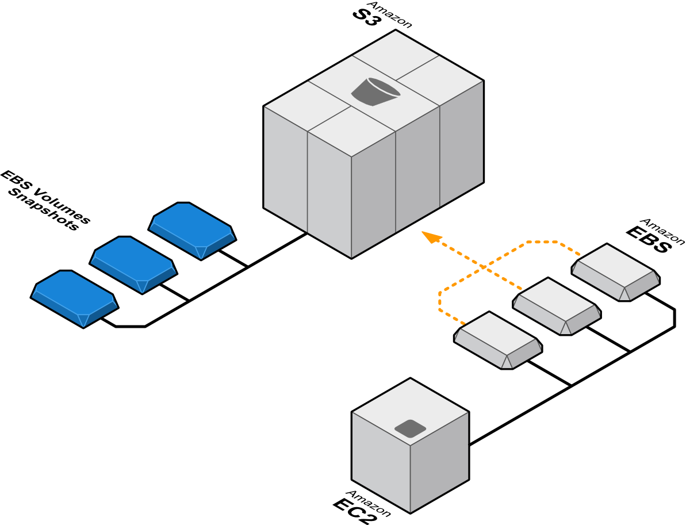

Slide 31
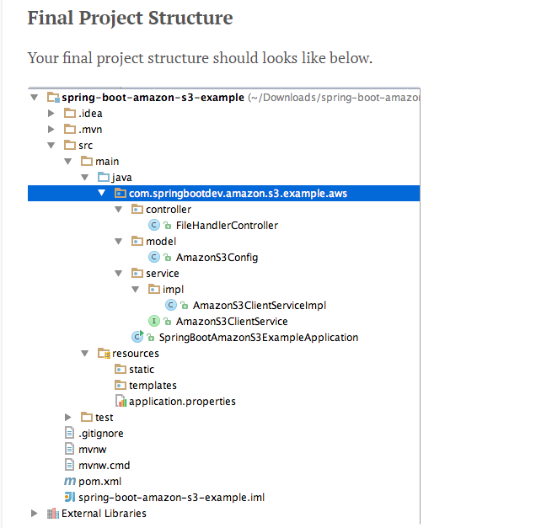
Spring Boot Amazon S3 client application

Slide 32
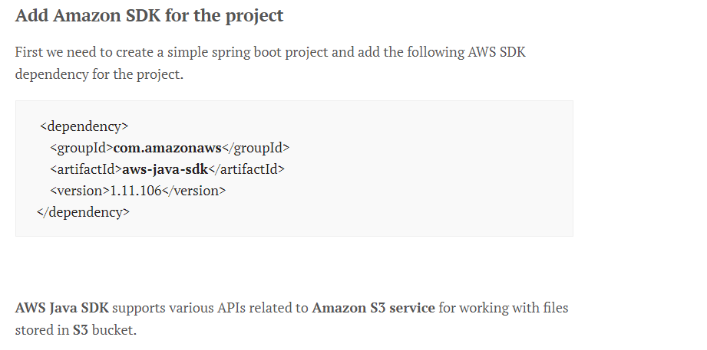

Slide 33
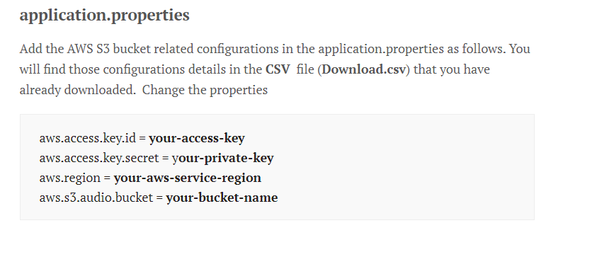

Slide 34
AmazonS3Config.java
Note Pad++

Slide 35
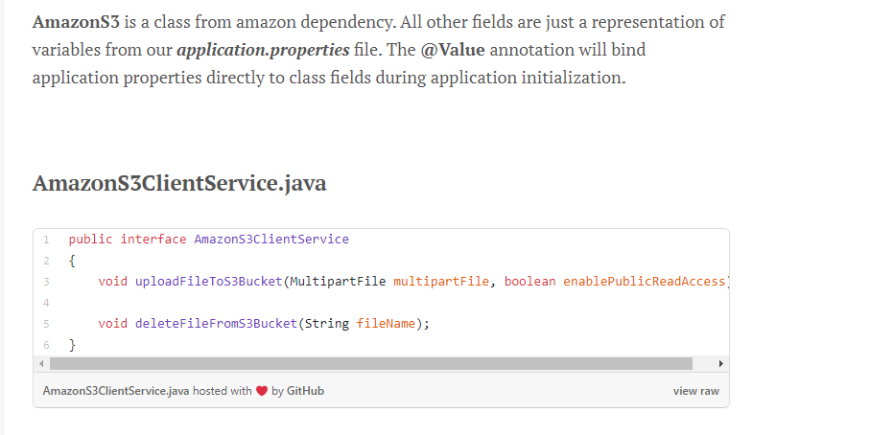

Slide 36
Thank you..!!

